Slide 1

Word Embedding
汤斯亮（Siliang Tang）
siliang@zju.edu.cn

Slide 2
How do we represent the meaning of a word?
Definition: meaning (Webster dictionary)
the idea that is represented by a word, phrase, etc.
the idea that a person wants to express by using words, signs, etc.
the idea that is expressed in a work of writing, art, etc. Commonest linguistic way of thinking of meaning:
signifier ⟺ signified (idea or thing) = denotation

Slide 3
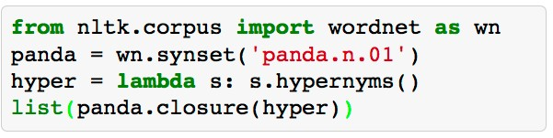


How do we have usable meaning in a computer?
Common answer: Use a taxonomy like WordNet that has hypernyms (is-a) relationships
and synonym sets
(here, for good):
S: (adj) full, good
S: (adj) estimable, good, honorable, respectable S: (adj) beneficial, good
S: (adj) good, just, upright
S: (adj) adept, expert, good, practiced, proficient, skillful
S: (adj) dear, good, near S: (adj) good, right, ripe
…
S: (adv) well, good
S: (adv) thoroughly, soundly, good S: (n) good, goodness
S: (n) commodity, trade good, good
[Synset('procyonid.n.01'), Synset('carnivore.n.01'), Synset('placental.n.01'), Synset('mammal.n.01'), Synset('vertebrate.n.01'), Synset('chordate.n.01'), Synset('animal.n.01'), Synset('organism.n.01'), Synset('living_thing.n.01'), Synset('whole.n.02'),
Synset('object.n.01'), Synset('physical_entity.n.01'), Synset('entity.n.01')]

Slide 4
Problems with this discrete representation
Great as a resource but missing nuances, e.g.,
synonyms:
adept, expert, good, practiced, proficient, skillful?
Missing new words (impossible to keep up to date): wicked, badass, nifty, crack, ace, wizard, genius, ninja
Subjective
Requires human labor to create and adapt
Hard to compute accurate word similarity

Slide 5
Problems with this discrete representation
The vast majority of rule-based and statistical NLP work regards words as atomic symbols
In vector space terms, this is a vector with one 1 and a lot of zeroes
[0 0 0 0 0 0 0 0 0 0 1 0 0 0 0]
Dimensionality: 20K (speech) – 50K (PTB) – 500K (big vocab) – 13M (Google 1T)
We call this a “one-hot” representation It is a localist representation

Slide 6
From symbolic to distributed representations
Sec. 9.2.2
Its problem, e.g., for web search
If user searches for [Dell notebook battery size], we would like to match documents with “Dell laptop battery capacity”
If user searches for [Seattle motel], we would like to match documents containing “Seattle hotel”
But
motel [0 0 0 0 0 0 0 0 0 0 1 0 0 0 0]^{T}
hotel [0 0 0 0 0 0 0 1 0 0 0 0 0 0 0] = 0
Our query and document vectors are orthogonal
There is no natural notion of similarity in a set of one-hot vectors
Could deal with similarity separately;
instead we explore a direct approach where vectors encode it

Slide 7
Distributional similarity based representations
You can get a lot of value by representing a word by means of its neighbors
“You shall know a word by the company it keeps”
(J. R. Firth 1957: 11)
One of the most successful ideas of modern statistical NLP
government debt problems turning into banking crises as has happened in
saying that Europe needs unified banking regulation to replace the hodgepodge
These words will represent banking

Slide 8
Word meaning is defined in terms of vectors
We will build a dense vector for each word type, chosen so that it is good at predicting other words appearing in its context
… those other words also being represented by vectors … it all gets a bit recursive
0.286
0.792
−0.177
−0.107
0.109
−0.542
0.349
0.271
linguistics =

Slide 10
Basic idea of learning neural network word embeddings
We define a model that aims to predict between a center word w_{t} and context words in terms of word vectors
p(context|w_{t}) = … which has a loss function, e.g.,
J = 1 − p(w_{−t} |w_{t})
We look at many positions t in a big language corpus
We keep adjusting the vector representations of words to minimize this loss

Slide 11
Directly learning low-dimensional word vectors
Old idea. Relevant for this lecture & deep learning:
Learning representations by back-propagating errors (Rumelhart et al., 1986)
A neural probabilistic language model (Bengio et al., 2003)
NLP (almost) from Scratch (Collobert & Weston, 2008)
A recent, even simpler and faster model: word2vec (Mikolov et al. 2013)

Slide 12
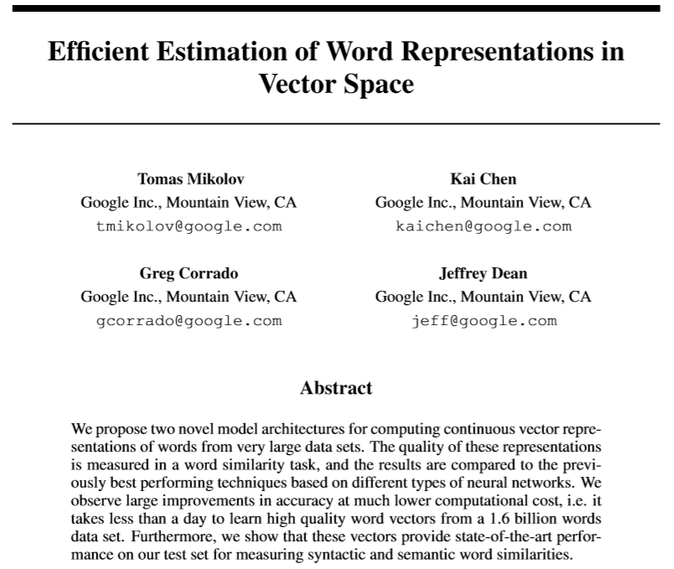
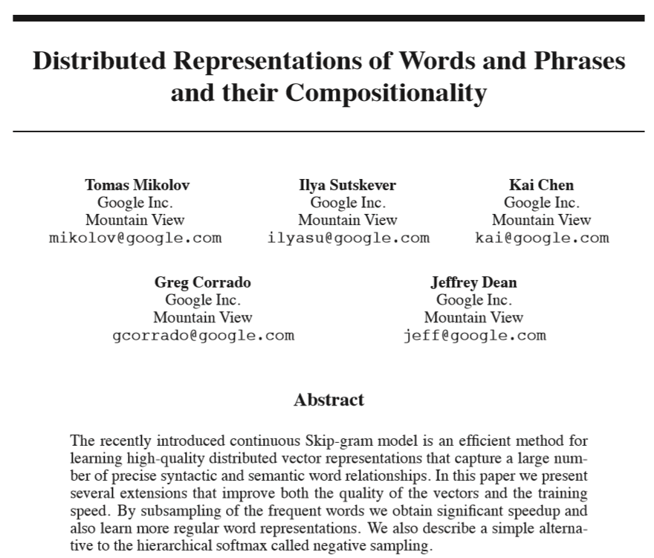
About word2vec...
Two original papers published in association with word2vec by Mikolov et al. (2013)

Slide 13
Word Vectors
juice
apple
orange
banana
rice
milk
bus
car
train

Slide 14
Word Analogy
king
queen
uncle
aunt
man
woman
Mikolov & Chen et al. 2013
Mikolov & Sutskever et al. 2013

Slide 15
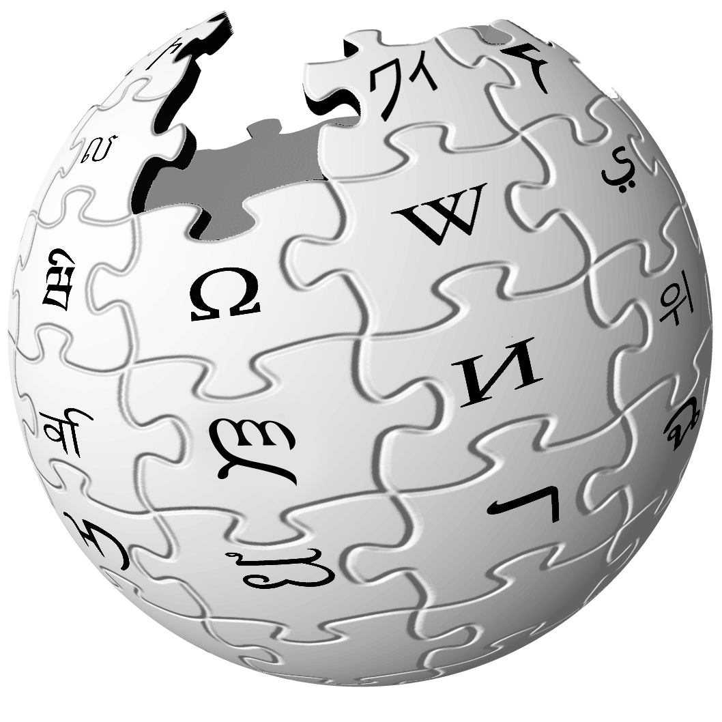

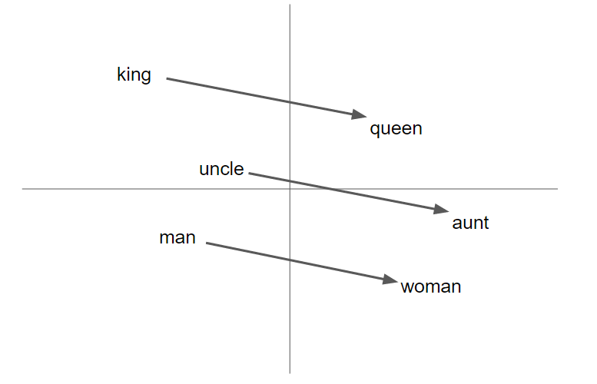
word2vec as a (powerful) black box
word2vec
Wikipedia

Slide 16
Applications of Word Vectors
Word Similarity
Classic Methods : Edit Distance, WordNet, Porter’s Stemmer, Lemmatization using dictionaries
Easily identifies similar words and synonyms since they occur in similar contexts
Stemming (thought -> think)
Inflections, Tense forms
eg. Think, thought, ponder, pondering,
eg. Plane, Aircraft, Flight

Slide 17
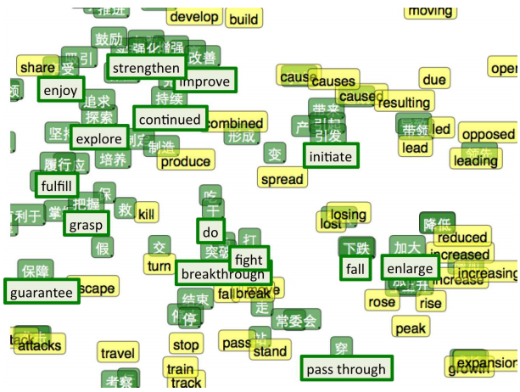
Applications of Word Vectors
2. Machine Translation
Classic Methods : Rule-based machine translation, morphological transformation

Slide 18
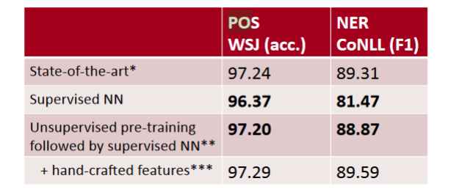
Applications of Word Vectors
3. Part-of-Speech and Named Entity Recognition
Classic Methods : Sequential Models (MEMM , Conditional Random Fields), Logistic Regression

Slide 19
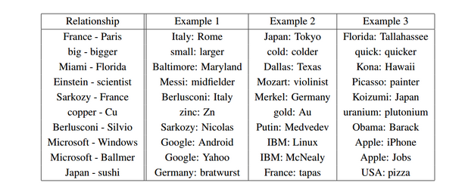
Applications of Word Vectors
4. Relation Extraction
Classic Methods : OpenIE, Linear programing models, Bootstrapping

Slide 20
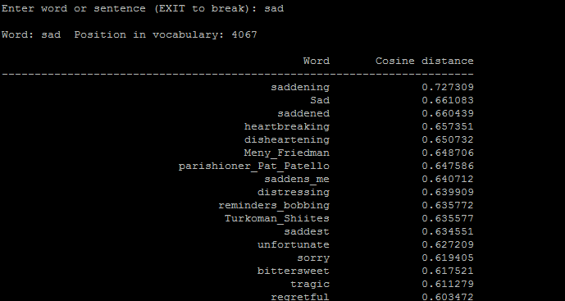
Applications of Word Vectors
5. Sentiment Analysis
Classic Methods : Naive Bayes, Random Forests/SVM
Classifying sentences as positive and negative
Building sentiment lexicons using seed sentiment sets
No need for classifiers, we can just use cosine distances to compare unseen reviews to known reviews.

Slide 21
Applications of Word Vectors
6. Co-reference Resolution
Chaining entity mentions across multiple documents - can we find and unify the multiple contexts in which mentions occurs?
7. Clustering
Words in the same class naturally occur in similar contexts, and this feature vector can directly be used with any conventional clustering algorithms (K-Means, agglomerative, etc). Human doesn’t have to waste time hand-picking useful word features to cluster on.
8. Semantic Analysis of Documents
Build word distributions for various topics, etc.

Slide 22
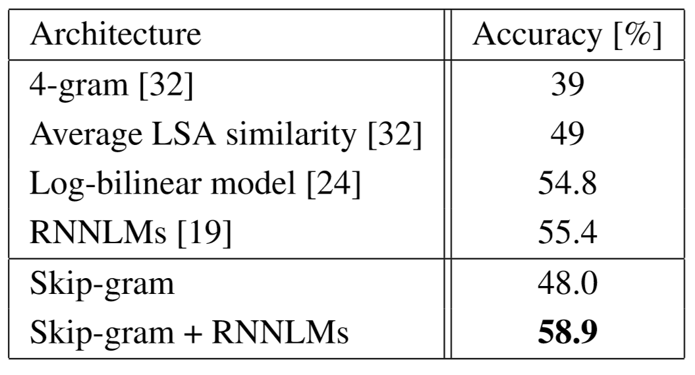
Other Applications benefited by word embeddings
Dependency parsing
Document classification
Paraphrase Detection
Table 7: Comparison and combination of models on the Microsoft Sentence Completion Challenge
"Efficient estimation of word representations in vector space" Mikolov & Chen et al. 2013

Slide 23
Contextual Representation
Word is represented by context in use
I eat an apple every day.
I eat an orange every day.
I like driving my car to work.

Slide 24
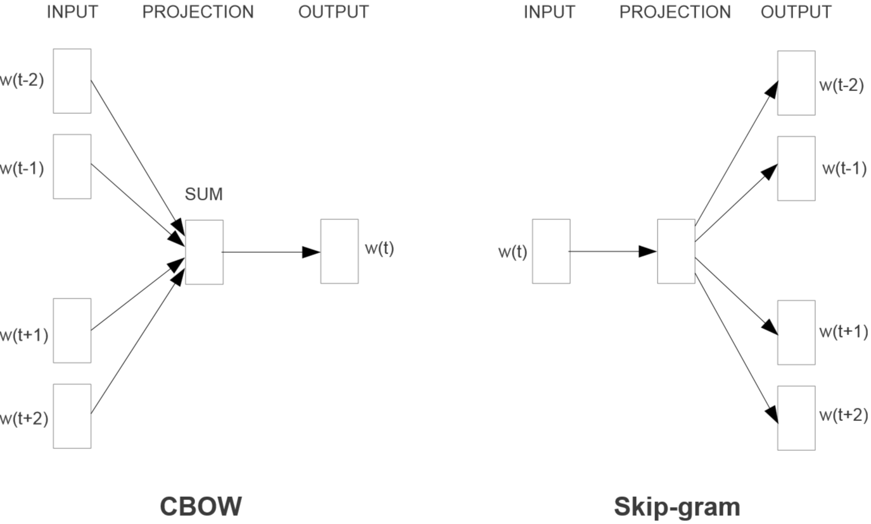

Slide 25
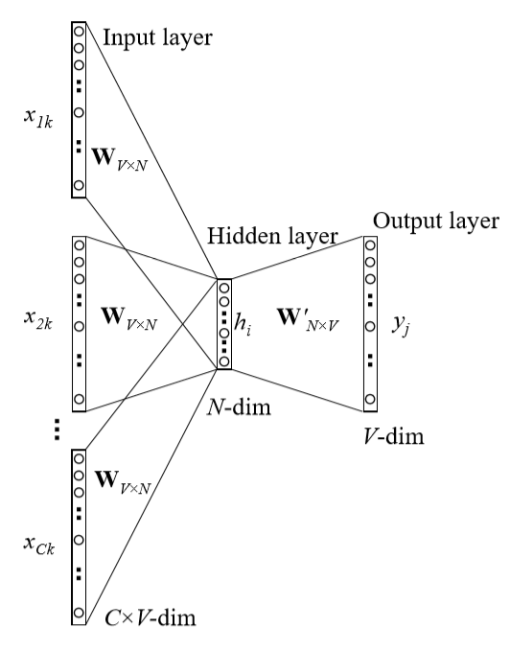
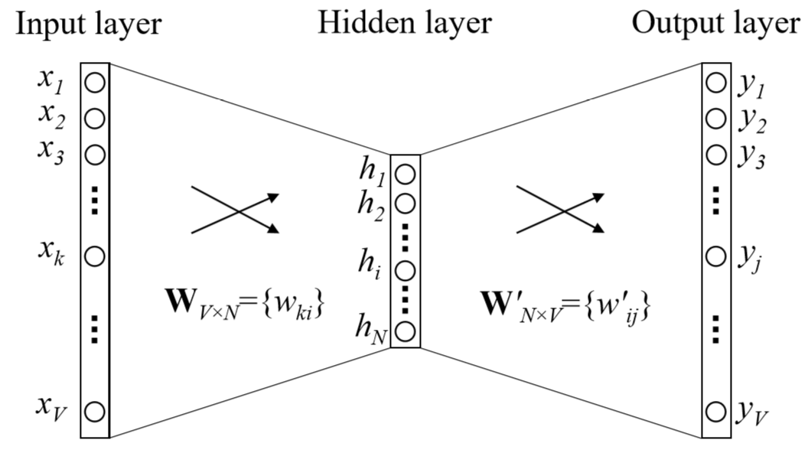
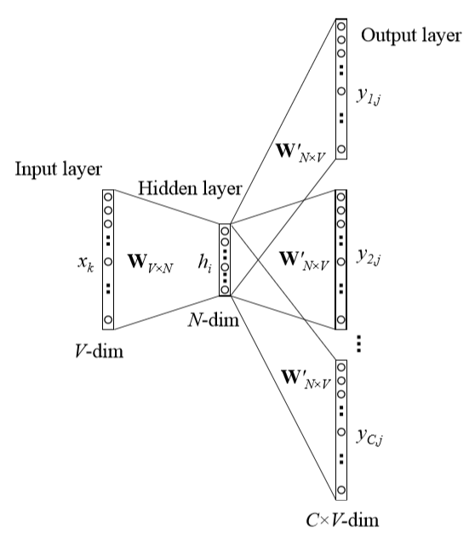
CBOW
word2vec model architecture
Skip-gram

Slide 26
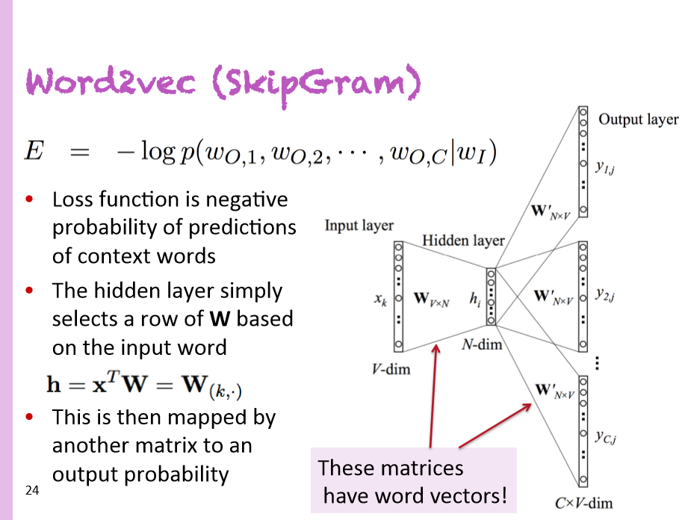
Christopher Manning
Deep Learning Summer School (2015)

Slide 27

Distributed Representation
Word is represented as continuous level of activations
apple
orange
car
inhibited
excited

Slide 28
word2vec decomposed
Input Corpus
Vocabulary
Builder
Lossy Counting
Vocabulary
Sentence Windows
Context Builder
Dynamic Window Scaling
Subsampling
Pruning
CBOW
Skip-gram
Input
Words
Output
Words
Vectors
(Final Product)
Parameter Learner
Backpropagation
Hierarchical Softmax
Negative Sampling

Slide 29
Word2Vec Visualization
https://ronxin.github.io/wevi/

Slide 30
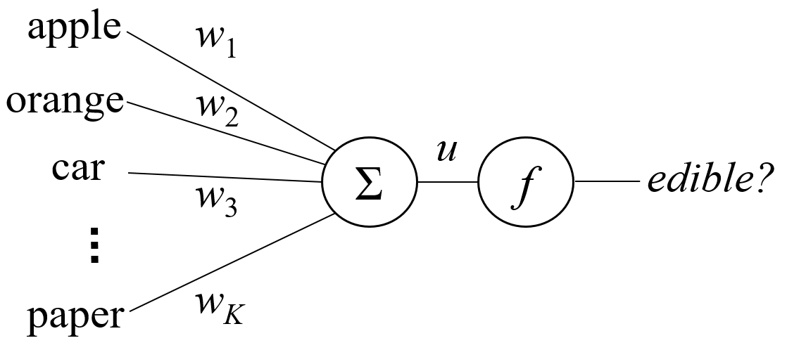
Task Afforded by a Single Neuron
A lookup table
Item | Edible?
apple | Y
orange | Y
car | N
... | ...
paper | N

Slide 31
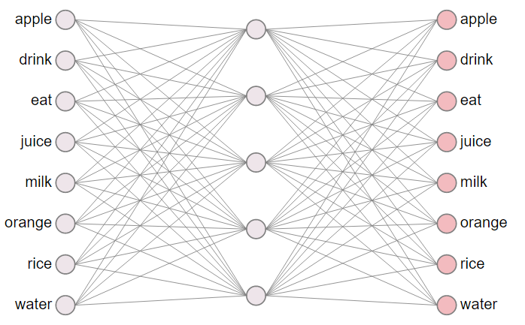
word2vec network
Structure Highlights:
input layer
one-hot vector
hidden layer
linear (identity)
output layer
softmax

Slide 32
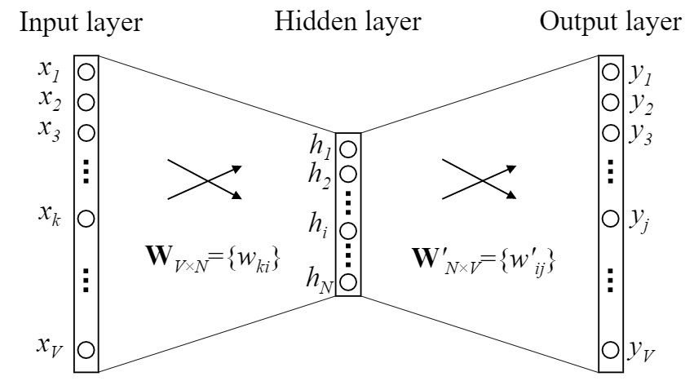
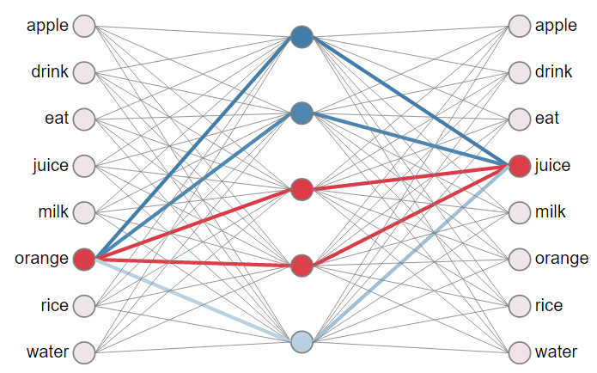

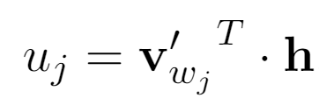
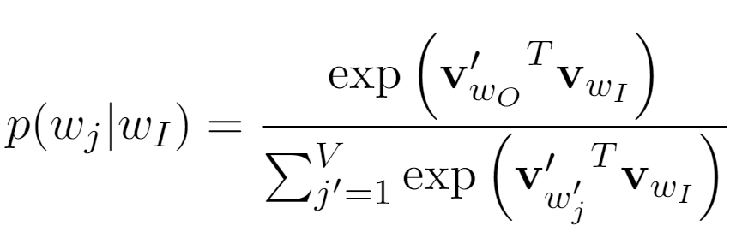
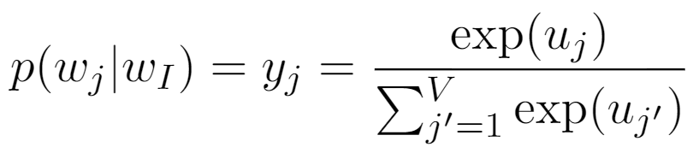
word2vec network

Slide 33
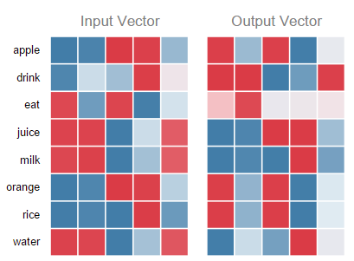
neural network and weight matrices

Slide 34
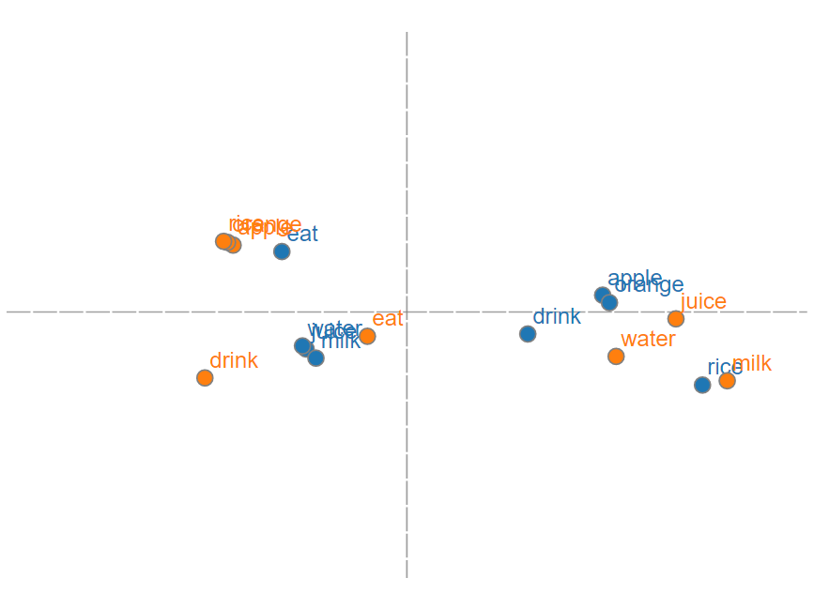
neural network and word vectors

Slide 35
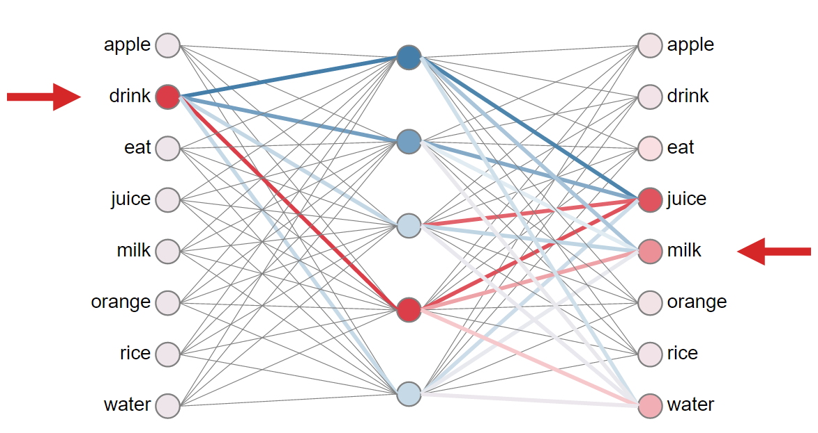
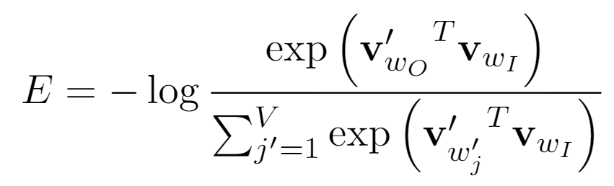
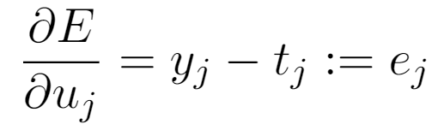
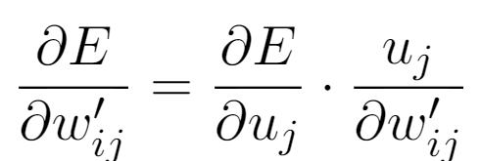
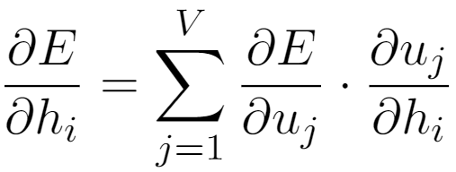
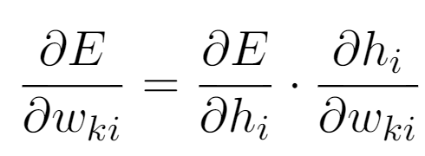
Training: updating word vectors

Slide 36
Calculating all gradients!
We went through gradient for each center vector v in a window
We also need gradients for outside vectors u
Derive at home!
Generally in each window we will compute updates for all parameters that are being used in that window.
For example, window size m = 1, sentence:
“We like learning a lot”
First window computes gradients for:
internal vector v_{like} and external vectors u_{We} and u_{learning}
Next window in that sentence?

Slide 37
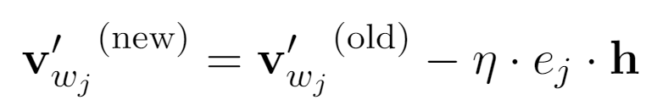
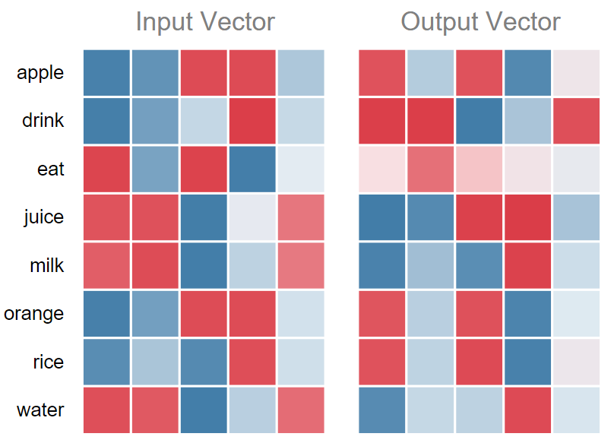
Intuition of output vector update rule

Slide 38
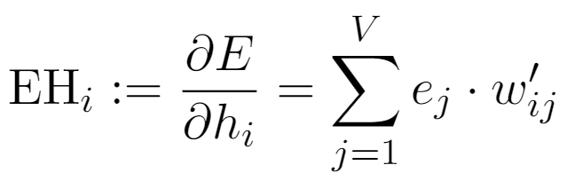

Intuitive Understanding of Input Vectors

Slide 39
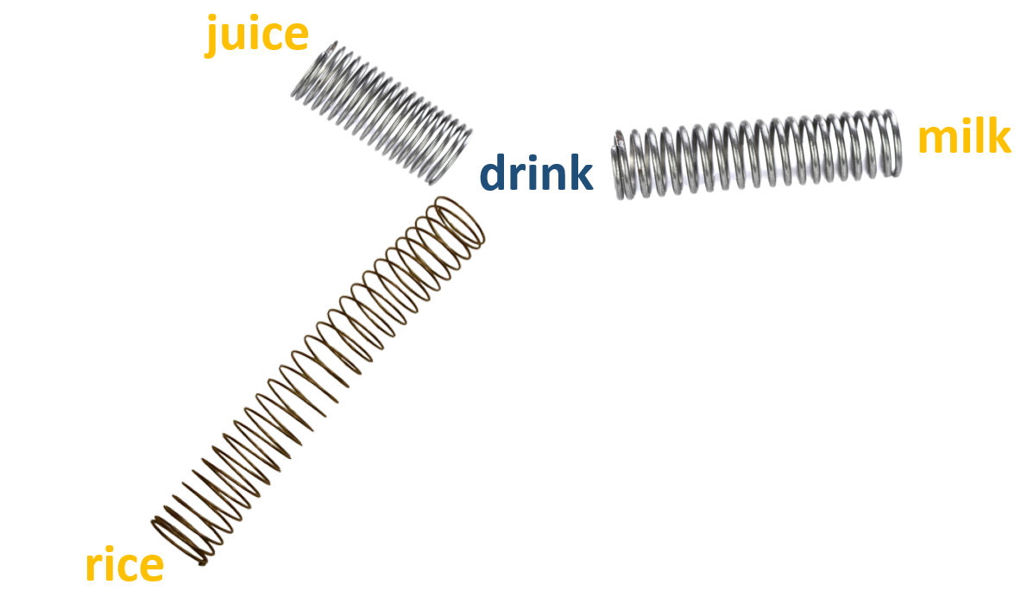
Resemblance to a force-directed graph
equilibrium length ~ - strength of co-occurrence
more on this later...

Slide 40
word2vec decomposed
Input Corpus
Vocabulary
Builder
Lossy Counting
Vocabulary
Sentence Windows
Context Builder
Dynamic Window Scaling
Subsampling
Pruning
CBOW
Skip-gram
Input
Words
Output
Words
Vectors
(Final Product)
Parameter Learner
Backpropagation
Hierarchical Softmax
Negative Sampling

Slide 41
How do we select input and output words?
Method 1: continuous bag-of-word (CBOW)
eat an apple every day
Method 2: skip-gram (SG)
eat an apple every day

Slide 42
demo
(CBOW and SG) https://ronxin.github.io/wevi/

Slide 43
word2vec decomposed
Input Corpus
Vocabulary
Builder
Lossy Counting
Vocabulary
Sentence Windows
Context Builder
Dynamic Window Scaling
Subsampling
Pruning
CBOW
Skip-gram
Input
Words
Output
Words
Vectors
(Final Product)
Parameter Learner
Backpropagation
Hierarchical Softmax
Negative Sampling

Slide 44
Training Generic Softmax is Intractable
need to update every single output vector!

Slide 45
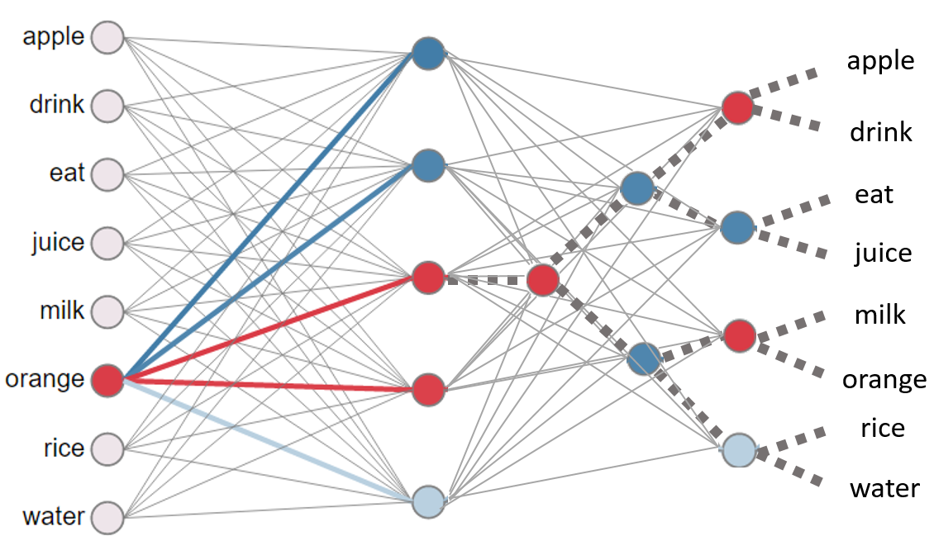
Hierarchical Softmax

Slide 46
Negative Sampling

Slide 47
word2vec decomposed
Input Corpus
Vocabulary
Builder
Lossy Counting
Vocabulary
Sentence Windows
Context Builder
Dynamic Window Scaling
Subsampling
Pruning
CBOW
Skip-gram
Input
Words
Output
Words
Vectors
(Final Product)
Parameter Learner
Backpropagation
Hierarchical Softmax
Negative Sampling

Slide 48
Limitations
Word ambiguity
Debuggability
Sequence
Notes:
Current model taking advantage;
word2vec train-split-train style
Existing work addressing this issue:
Huang, Socher, Manning & Ng, 2012;
Trask, Gilmore, Russel, 2015

Slide 49
Any Questions?

